Slide 1
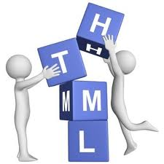
HTML
Lesson 1

Slide 2
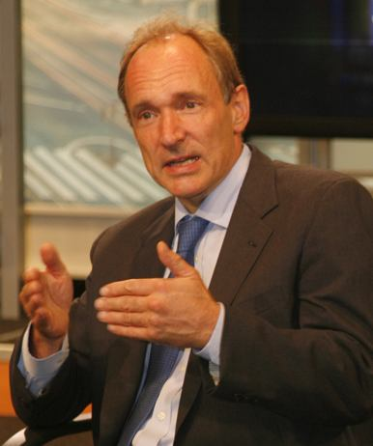
What is HTML?
HTML – HyperText Markup Language
HTML is a markup language.
HTML - easiest language.
Tim Berners-Lee

Slide 3
HTML Versions
Version | Year
HTML | 1991
HTML+ | 1993
HTML 2.0 | 1995
HTML 3.2 | 1997
HTML 4.01 | 1999
XHTML 1.0 | 2000
HTML5 | 2012

Slide 4
HTML – Tags
HTML markup tags are usually called HTML tags
<tagname>content</tagname>
"HTML tags" and "HTML elements" are often used to describe the same thing.
<p> This is a paragraph. </p>

Slide 5
The <!DOCTYPE> Declaration
HTML5
<!DOCTYPE html>
HTML 4.01
<!DOCTYPE HTML PUBLIC "-//W3C//DTD HTML 4.01 Transitional//EN"
"http://www.w3.org/TR/html4/loose.dtd">
XHTML 1.0
<!DOCTYPE html PUBLIC "-//W3C//DTD XHTML 1.0 Transitional//EN"
"http://www.w3.org/TR/xhtml1/DTD/xhtml1-transitional.dtd">

Slide 6
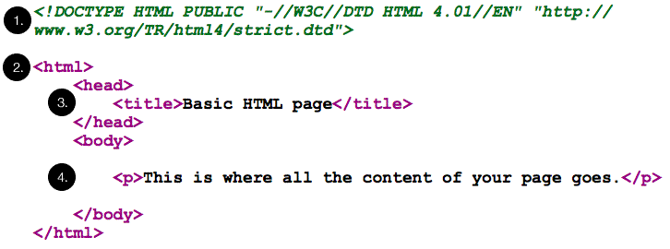
HTML – Document structure

Slide 7
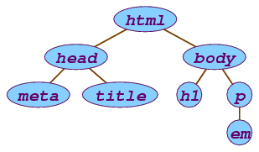
HTML – document structure

Slide 8
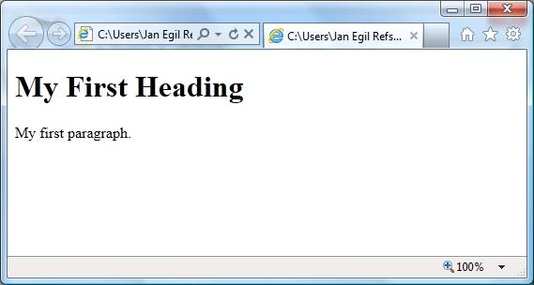
Web Browsers
The purpose of a web browser is to read HTML documents and display them as web pages.
<!DOCTYPE html>
<html>
<body>
<h1>My First Heading</h1>
<p>My first paragraph.</p>
</body>
</html>

Slide 9
HTML – Headings and Paragraphs
<!DOCTYPE html>
<html>
<body>
<h1>This is heading1</h1>
<h2>This is heading 2</h2>
<h3>This is heading 3</h3>
<h4>This is heading 4</h4>
<h5>This is heading 5</h5>
<h6>This is heading 6</h6>
</body>
</html>
<!DOCTYPE html>
<html>
<body>
<p>This is a paragraph.</p>
<p>This is a paragraph.</p>
<p>This is a paragraph.</p>
</body>
</html>
h1 { font-size: 2em; }
h2 { font-size: 1.5em; }
h3 { font-size: 1.17em; }
h5 { font-size: .83em; }
h6 { font-size: .75em; }

Slide 10
HTML – Attributes
<tagname attributename=“attributevalue”>
Content
</tagname>
<a href=“http://www.nverner.am” >
This is a link
</a>

Slide 11
HTML - Text Formatting
Tag | Description
<b> | Defines bold text
<i> | Defines a part of text in an alternate voice or mood
<small> | Defines smaller text
<sub> | Defines subscripted text
<sup> | Defines superscripted text
<ins> | Defines inserted text
<del> | Defines deleted text
<mark> | Defines marked/highlighted text

Slide 12
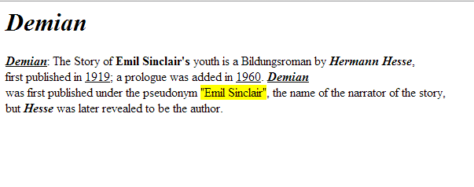
Task:1

Slide 13
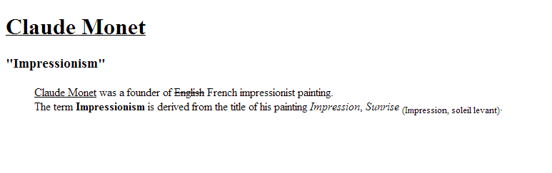
Task:2

Slide 14
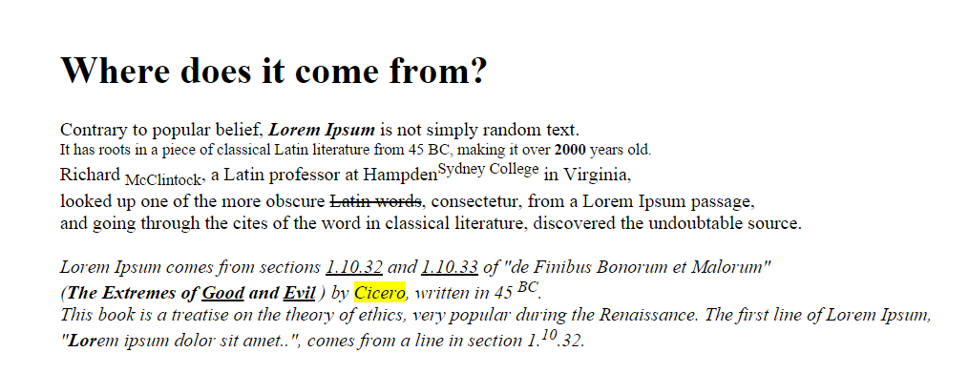
Task:3

